Slide 1

Toronto FC Social Media Selection
Cooper INCORPORATED WK2 PRESENTATION

Slide 2





TEAM
Chibuike Okoroama
Prescila Mora
Mohamed Afhab
Venkata Manish

Slide 3

Name: Toronto FC (Football club)
Location: Bay St. Toronto, Ontario
Phone: (416) 360-4625 Fan Base: “Red Boys”
Field Capacity: 30,000 seats
Worth: $690mil
CLIENT

Slide 4
AGENDA
SOCIAL MEDIA & TOOLS INTRODUCTION
01
SOCIAL MEDIA TYPES
02
SOCIAL MEDIA COMPARISONS
03
CONCLUSION
04

Slide 5
INTRODUCTION
Social Media Analytics is about collecting, measuring and analyzing engagements from various social media platforms to understand human behaviour.
Purpose is that provides insights into the fans’ interaction with Toronto FC content on various social media platforms and help Toronto FC to shape its strategies to improve engagement and reach.

Slide 6
TOOLS BENEFITS
Data Collection: Allows data collection from various social media platforms in one place for a complete understanding of fans engagement across.
Deep Analytics: Understand the sentiments, demographics, behaviours beyond basic likes and shares. Then predict using machine learning or AI.
Real Time tracking: During matches can monitor fan interactions and trends and help to adapt to marketing strategies on real-time data.
Competitive Analysis: Ability to compare Toronto FC’s performance with competitors, identify opportunities based on competitive performance to gauge relative success

Slide 7

BIG DATA TOOL
Buffer would be ideal for Toronto FC for simple tools to monitor and manage posts and fans interactions.
Buffer tracks performance metrics like comments, shares on post. Can schedule content across various social media platforms and can provide insights on best time to post.
Buffer free plan supports limited account and basic analytics which is sufficient for small campaigns.

Slide 8

BIG DATA TOOL
Hootsuite can help Toronto FC to efficiently manage various platforms, get detailed performance reports and useful for large-scale fan engagement strategies.
Hootsuite allows tracking multiple profiles, deep insight into social media performance, provide detail data engagement and help optimize content
Hootsuite has 30 days trial that allows Toronto FC to test its capabilities.

Slide 9
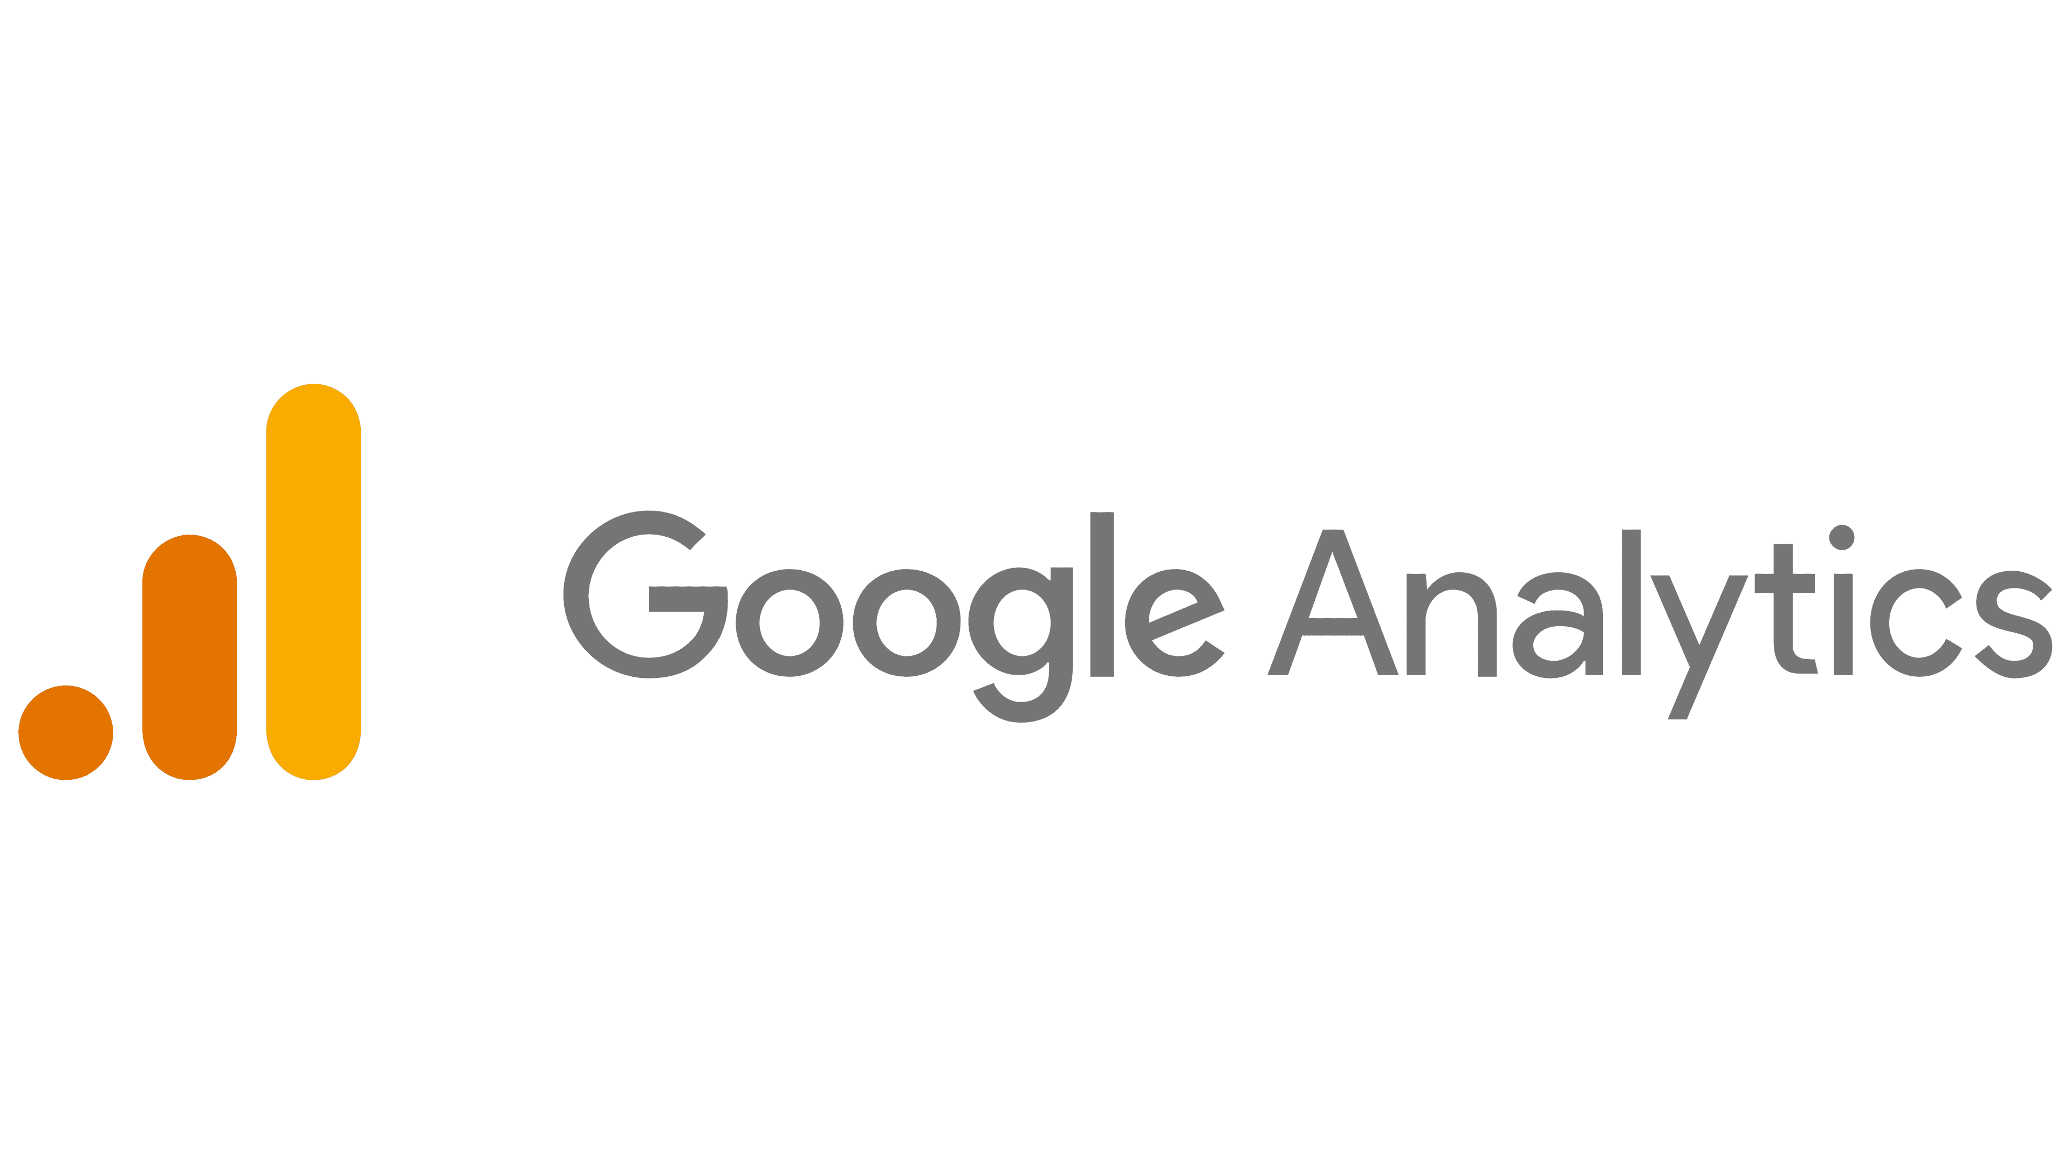
BIG DATA TOOL
Google analytics mainly track broader impact of social media campaign, especially how social media drives fan engagement off-platform like tickets & membership.
Google offers insights on social media traffic, shows which social media channel are effective at engaging the fans
Google Free functional tool

Slide 10

BIG DATA TOOL
Sprout social is good for creating long-term fan engagement strategies. It can show fans interaction over time and offer suggestions on how to tweak social media campaigns to maximize engagement.
Sprout social Offers deep social analytics and reporting that can help Toronto FC track post-performance like their hashtags, key words to understand the fans.
Sprout social 30 days trial is available

Slide 11

BIG DATA TOOL
Zoho social is vital to understand what content drives the most integrations show a good picture of when fans are engaging.
Zoho social Offers social media scheduling and post analytics, provides insights into engagement levels, including who interacted and when. Makes it easier to target the right content by showing fans demographic and social behaviour.
Zoho social subscription based

Slide 12
BIG DATA TOOLS COMPARISON
TOOLS | PLATFORM SUPPORT | ANALYTIC DEPTH | REAL-TIME DATA | AUDIENCE INSIGHTS | REPORTING & VISUALIZATION | COMPETITIVE ANALYSIS | FREE VERSION
Buffer | Facebook, Twitter, Instagram, LinkedIn | Basic engagements metrics (likes, shares) | No | limited | Simple report | No | Yes (limited)
Hootsuite | Multiple (Facebook, Twitter, Instagram, LinkedIn) | Deep, multi-platform analytics | No | Yes | Comprehensive reporting tools | No | 30-day trial
Google Analytics | All platforms via website integration | Traffic and conversion metrics from social platforms | No | Yes | Advanced reporting for web-related data | No | Yes (fully free)
Sprout Social | Facebook, Twitter, Instagram, LinkedIn, Pinterest | Advanced social analytics | No | Yes | Detailed, automated reports | Yes | 30 days trial
Zoho Social | Facebook, Twitter, Instagram, LinkedIn | Engagement metrics | No | Yes | Basic reports | No | Limited

Slide 13
RECOMMENDATION
Advance analytics & AI Insights: With Sprout Social, Toronto FC will understand how the fans are interacting with the club’s content, allowing for the creation of impactful strategies. With the AI-powered insights, a comprehensive analytics including the fan engagement, sentiment analysis and audience insights.
Real-time Data tracking: Gives the marketing team an edge to make agile adjustments to content and campaigns based on real-time fan reactions. This makes monitoring social media interactions as the happen.
Scalability: Accommodates the expansion of social media expansion with the increase in data demands and provide insights needed to stay competitive.

Slide 14
RECOMMENDATION
Comprehensive Reporting: Gives the marketing team an edge in decision making, thereby allowing for a data-driven insight presentation of fan engagement and social media performance. With the customized reporting tools, it is easy to generate detailed visual reports for Toronto FC stakeholders.
Multi-Platform Support: Can cover all important social media platforms, thereby ensuring that Toronto FC can reach and engage fans across various social media channels.

Slide 15
CONCLUSION
Sprout Social is the ideal tool to manage the extensive interactions of Toronto FC fans across different social media platforms. With its advanced features like deep insights and real-time data tracking, will give the marketing team an edge to create highly targeted and response fan engagement.
While Sprout Social does require a subscription, its powerful capabilities and comprehensive reporting make it a valuable investment, ensuring that Toronto FC maintains a strong and engaging presence across all platforms, effectively connecting with fans in meaningful ways.

Slide 16
THANK YOU

